Slide 1
Week 1
Foundations

Slide 2
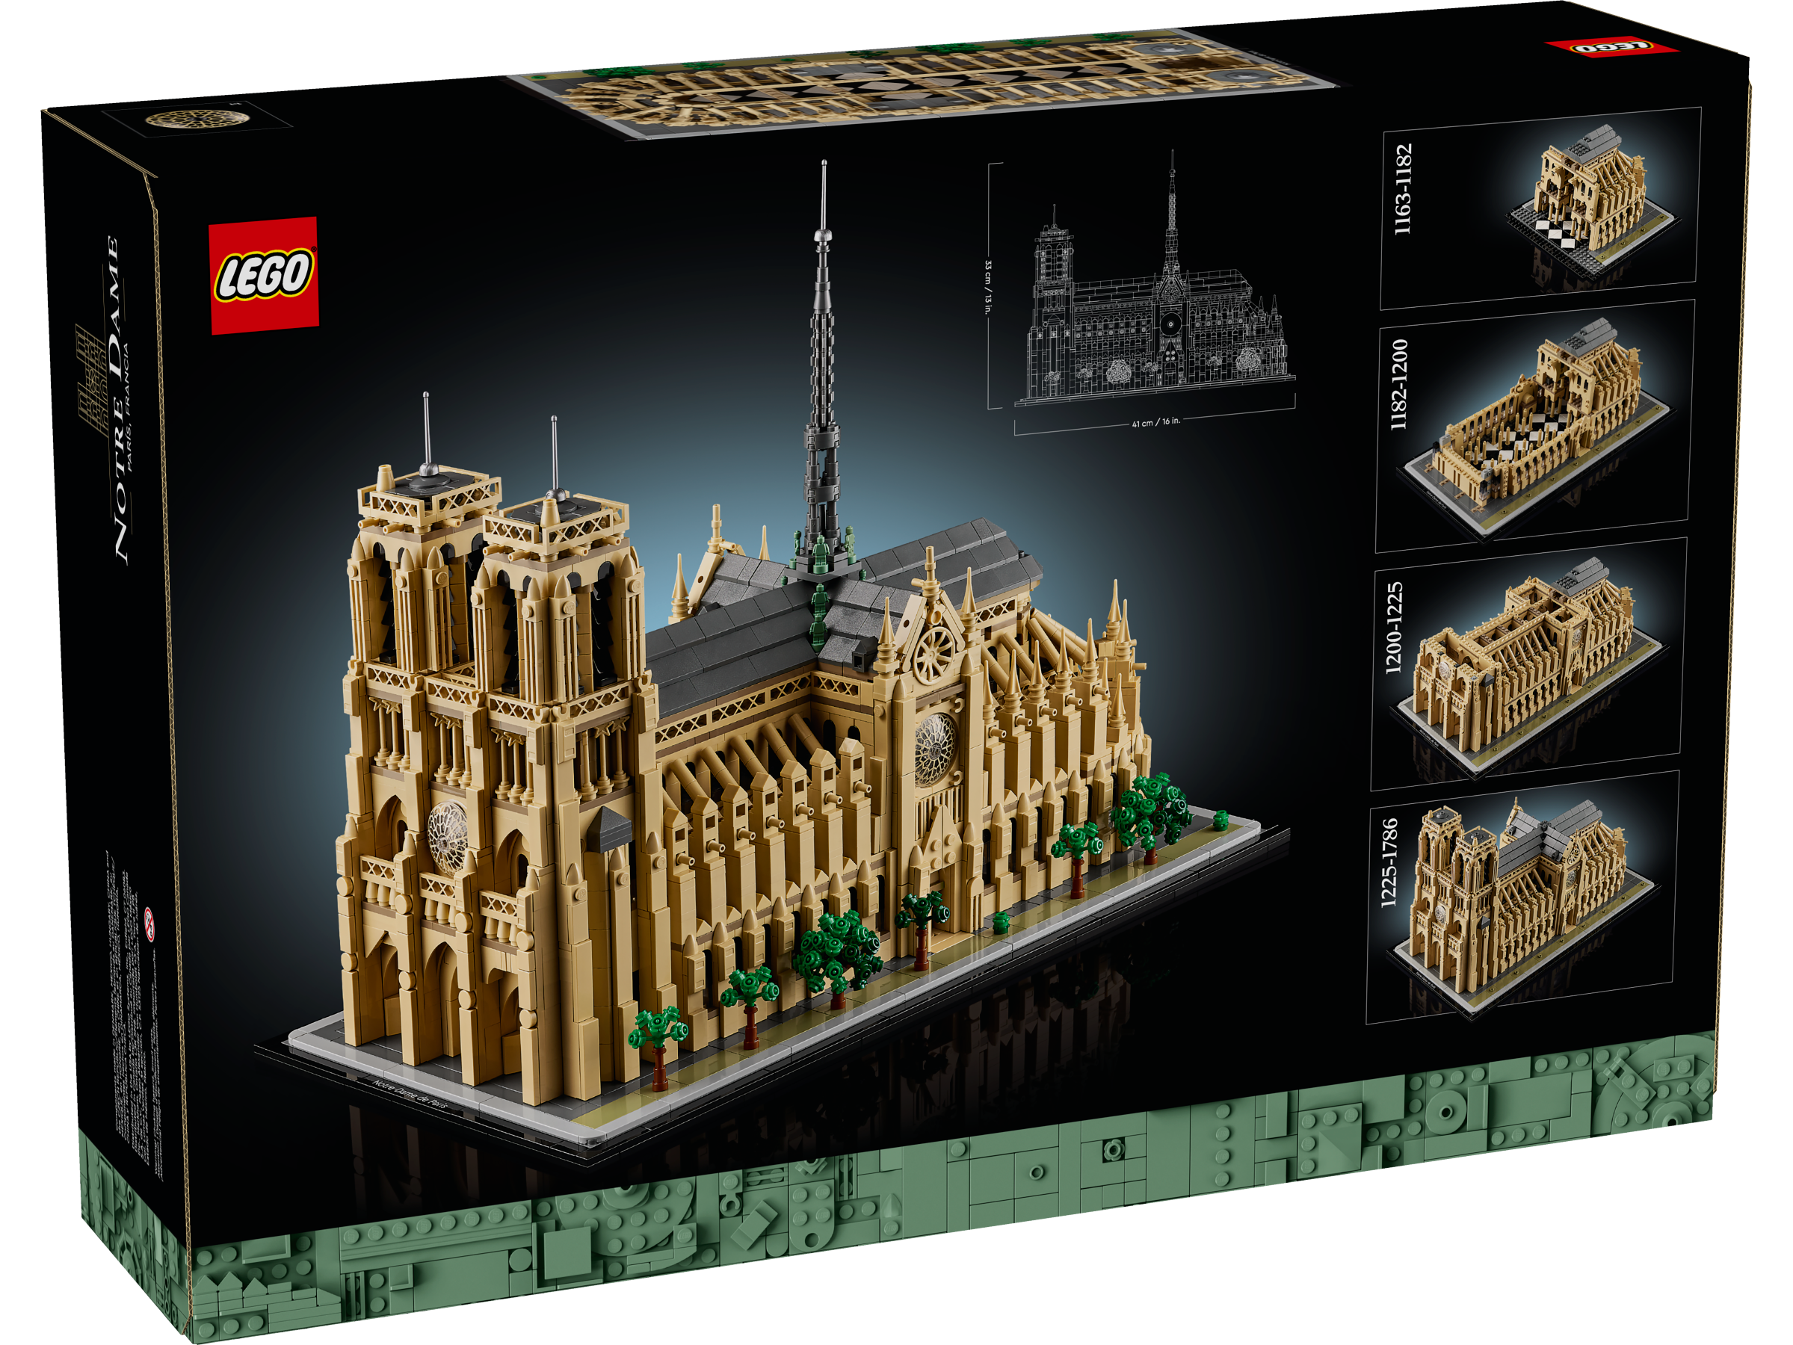
Notes:
This slide [CHILDREN’S TIME] is not shown.
VIDEO SWITCH: GOTO LS (live Stream)

Slide 3
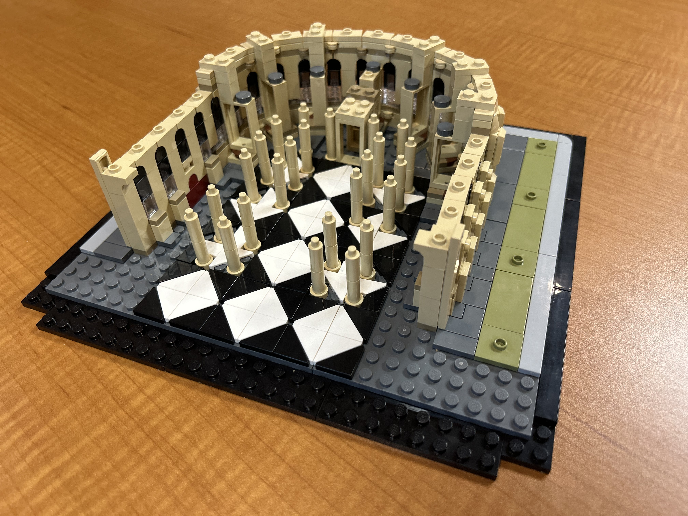
Notes:
This slide [CHILDREN’S TIME] is not shown.
VIDEO SWITCH: GOTO LS (live Stream)

Slide 4
Week 2
Flying Buttresses: Support

Slide 5
Notes:
This slide [CHILDREN’S TIME] is not shown.
VIDEO SWITCH: GOTO LS (live Stream)

Slide 6
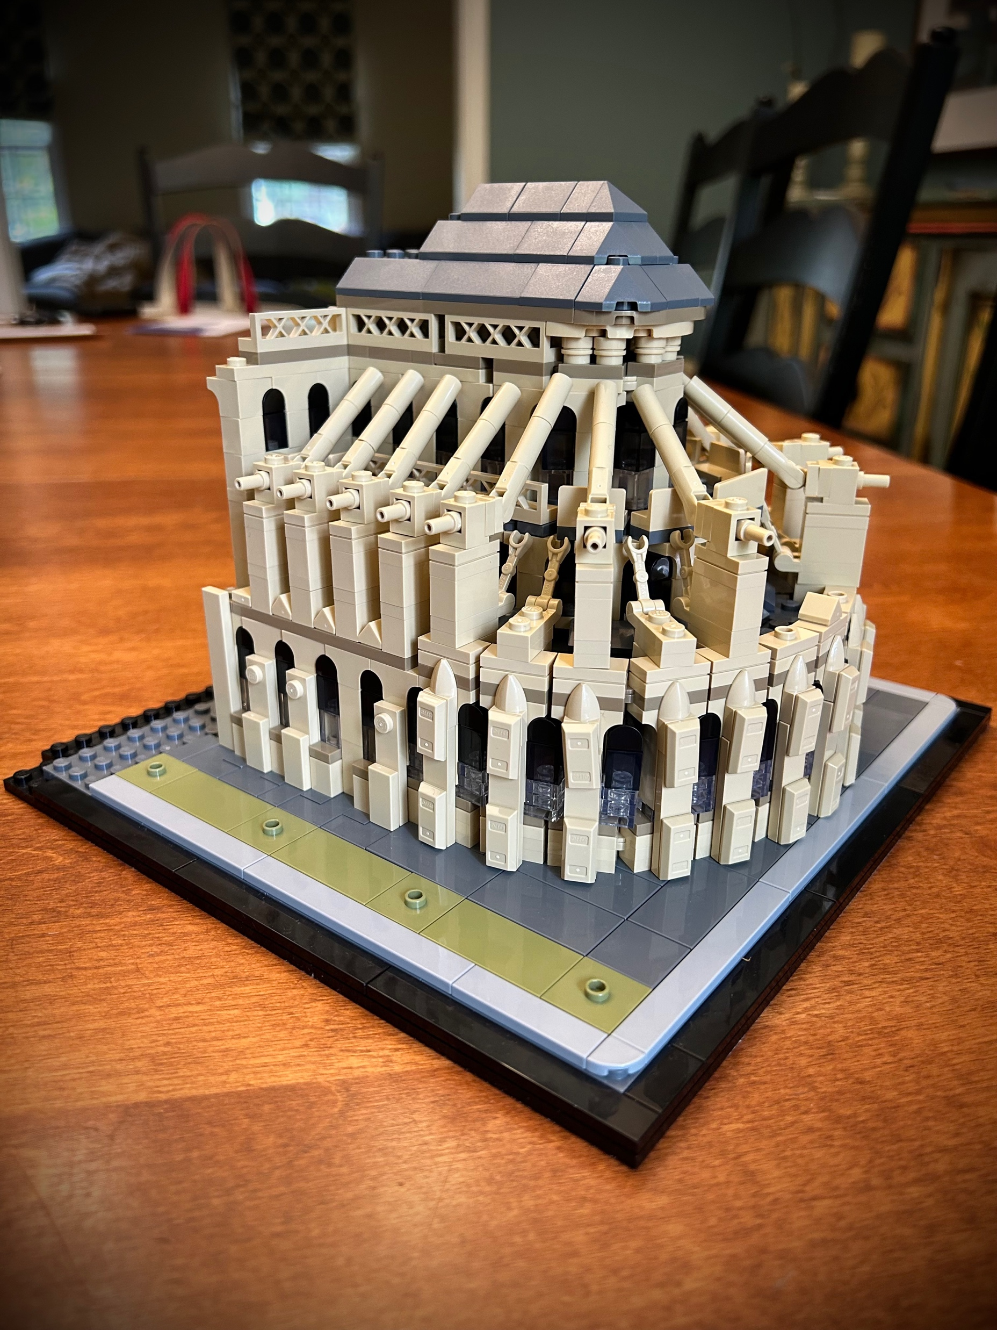
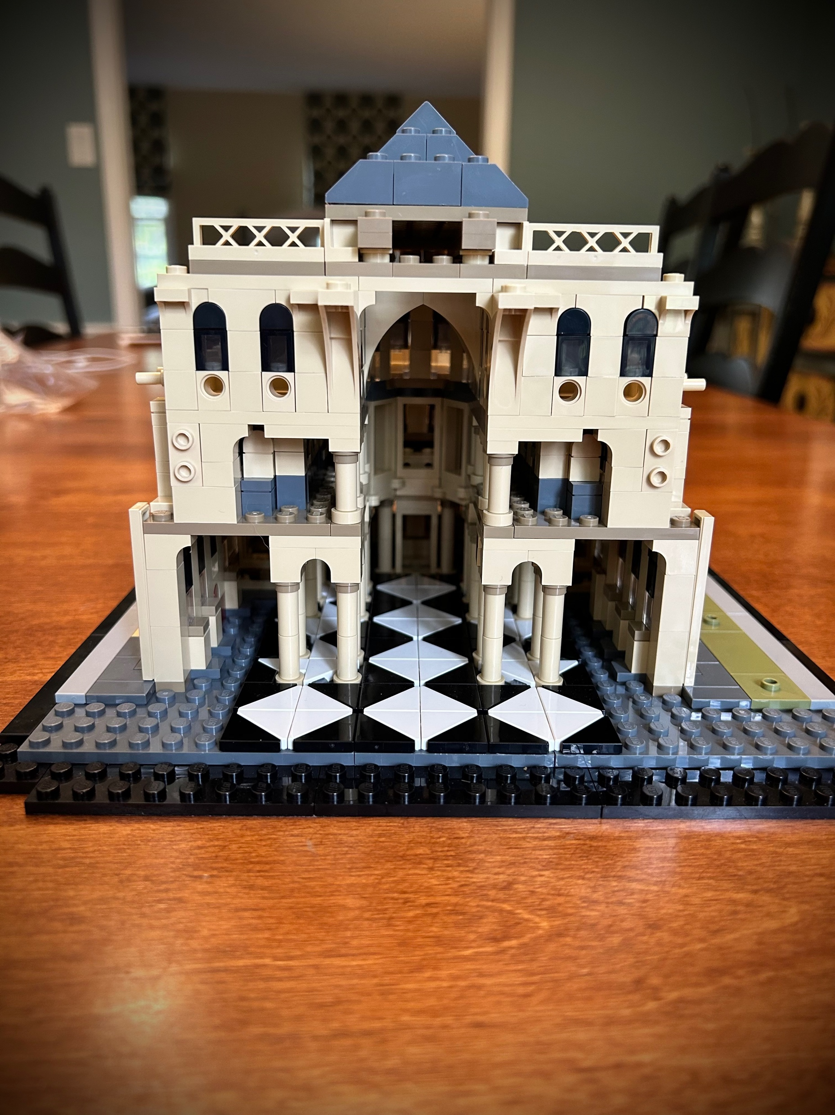
Notes:
This slide [CHILDREN’S TIME] is not shown.
VIDEO SWITCH: GOTO LS (live Stream)

Slide 7
Week 3
Nave: A Place and Space for All

Slide 8
Notes:
This slide [CHILDREN’S TIME] is not shown.
VIDEO SWITCH: GOTO LS (live Stream)

Slide 9
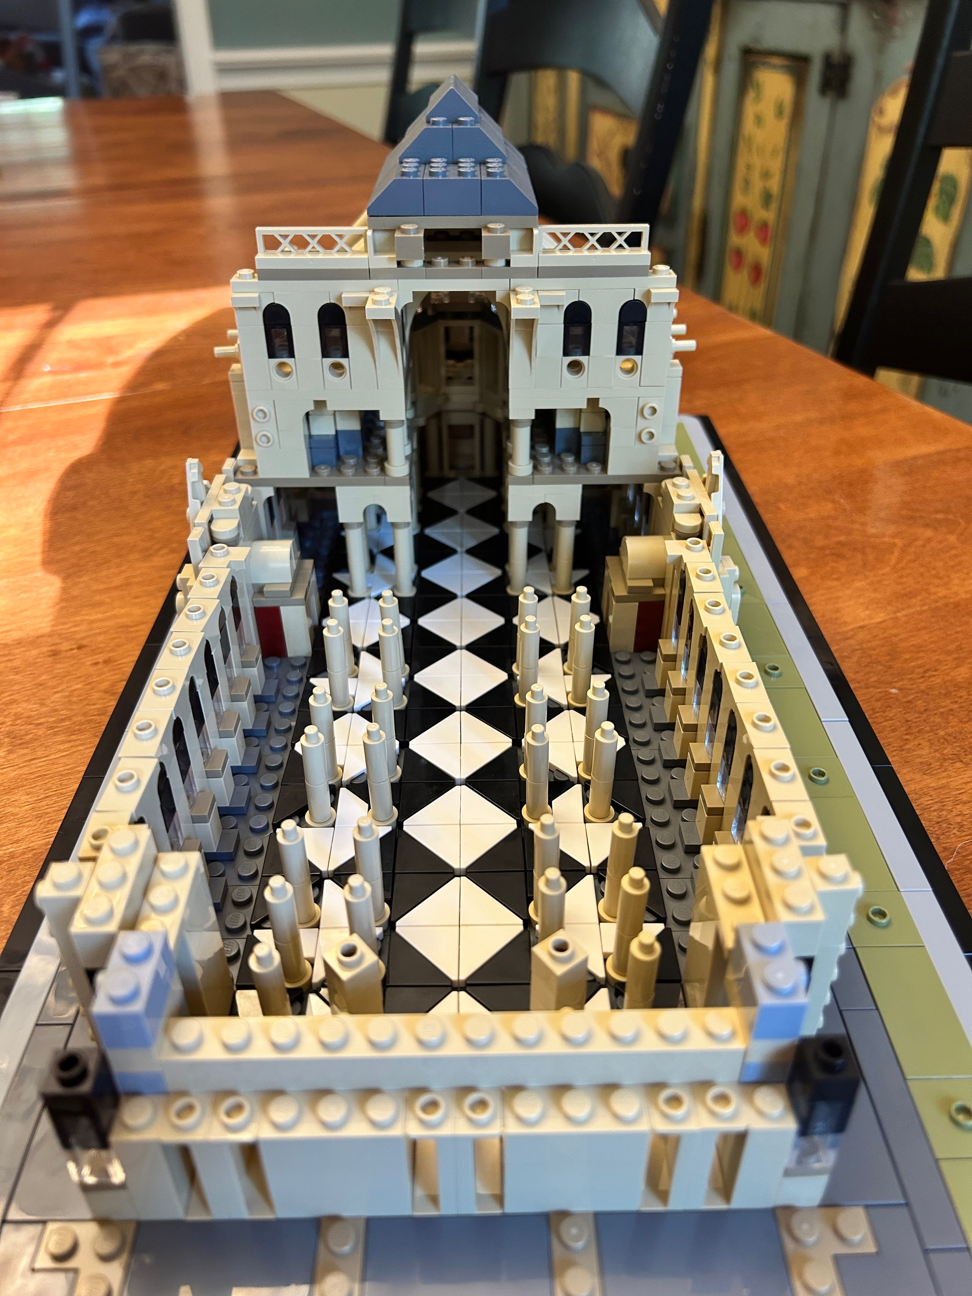
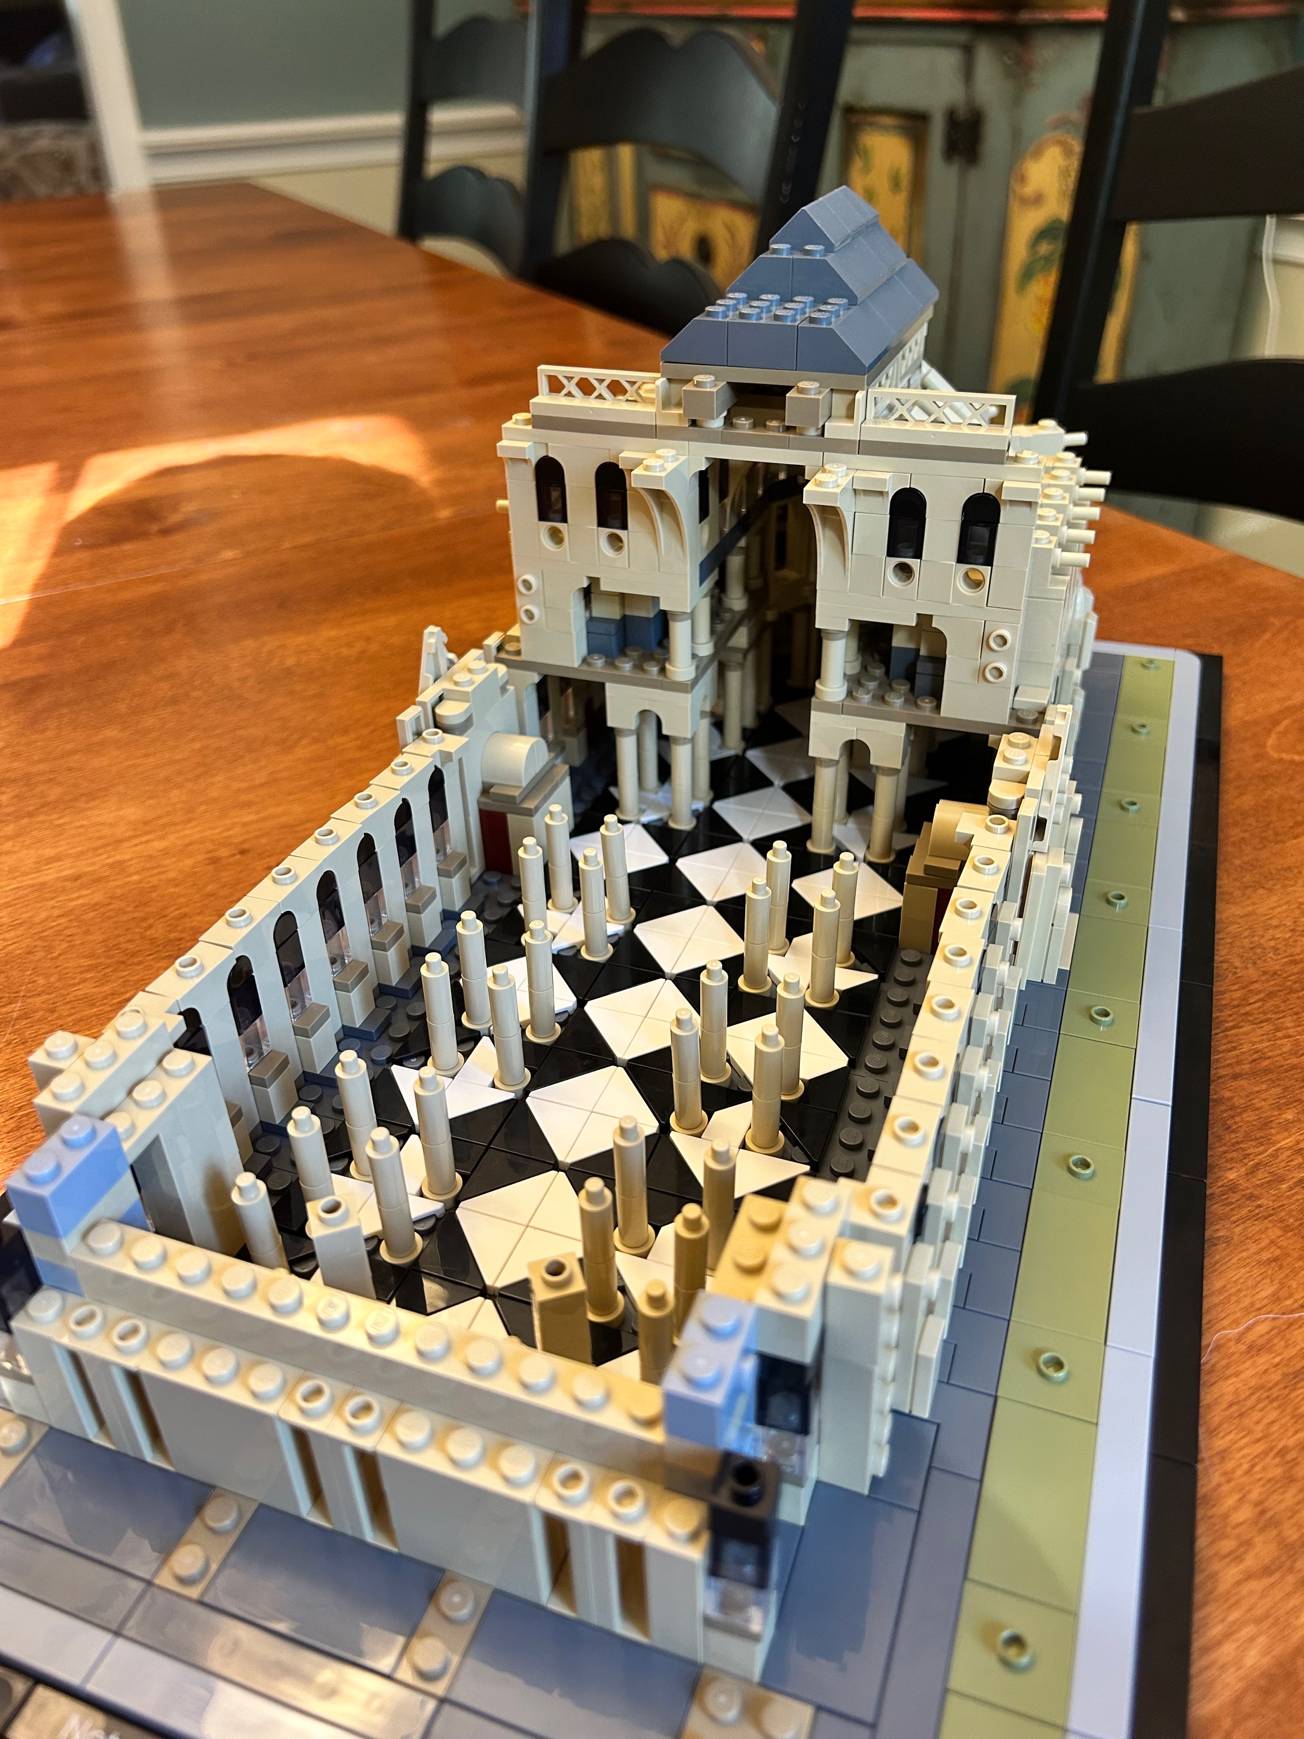
Notes:
This slide [CHILDREN’S TIME] is not shown.
VIDEO SWITCH: GOTO LS (live Stream)

Slide 10
Week 4
We are Cross Shaped

Slide 11
Notes:
This slide [CHILDREN’S TIME] is not shown.
VIDEO SWITCH: GOTO LS (live Stream)

Slide 12
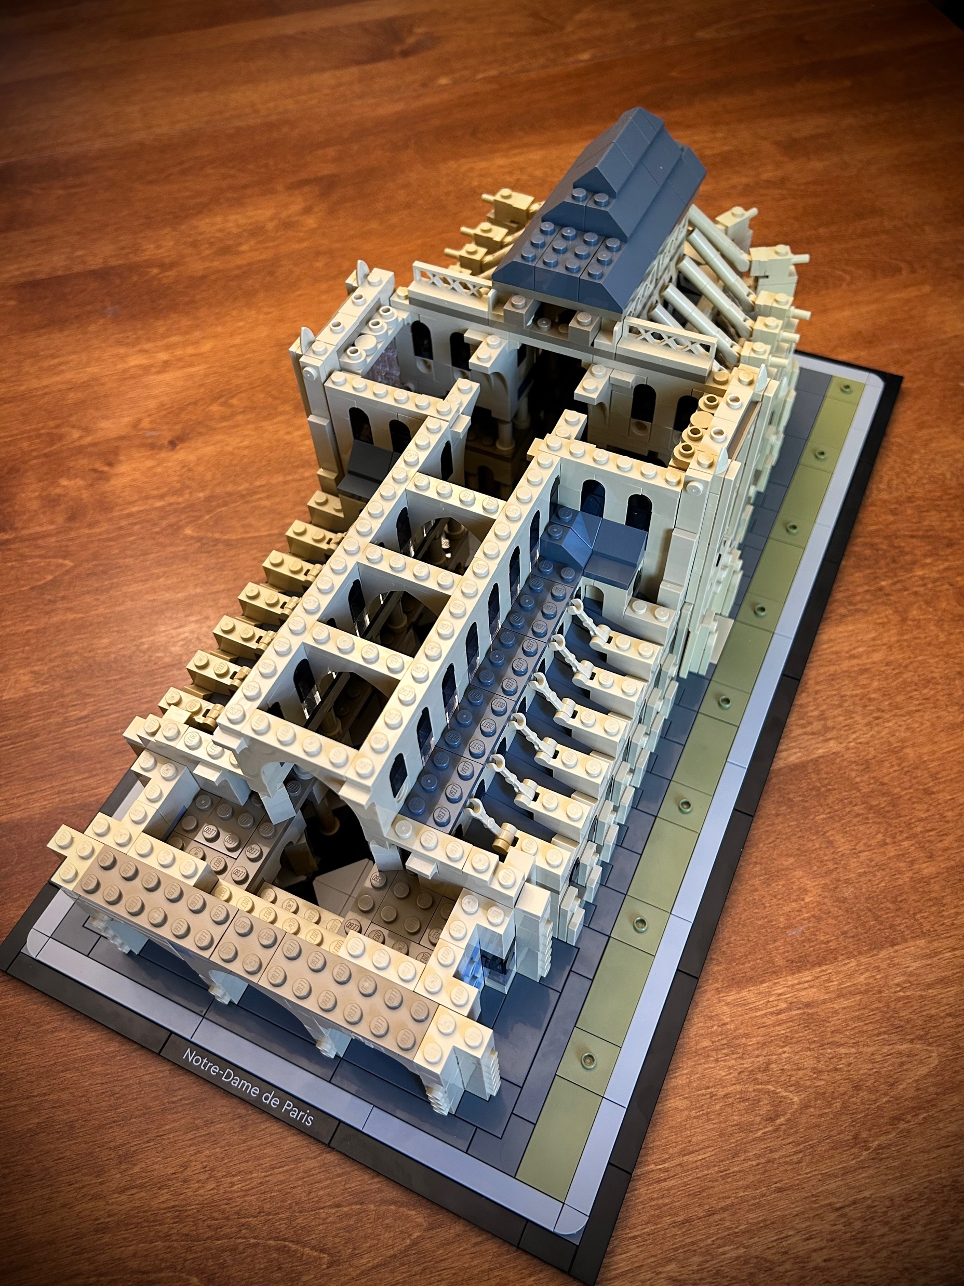
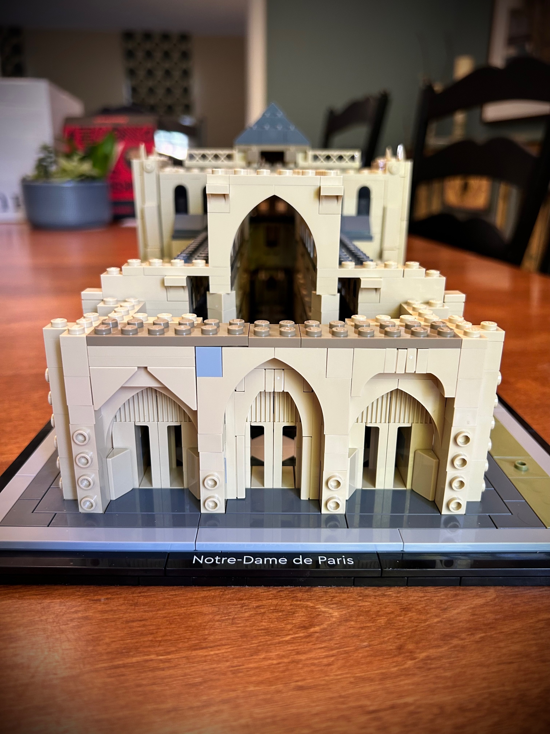
Notes:
This slide [CHILDREN’S TIME] is not shown.
VIDEO SWITCH: GOTO LS (live Stream)

Slide 13
Week 5
Entrances: Many Ways In

Slide 14
Notes:
This slide [CHILDREN’S TIME] is not shown.
VIDEO SWITCH: GOTO LS (live Stream)

Slide 15
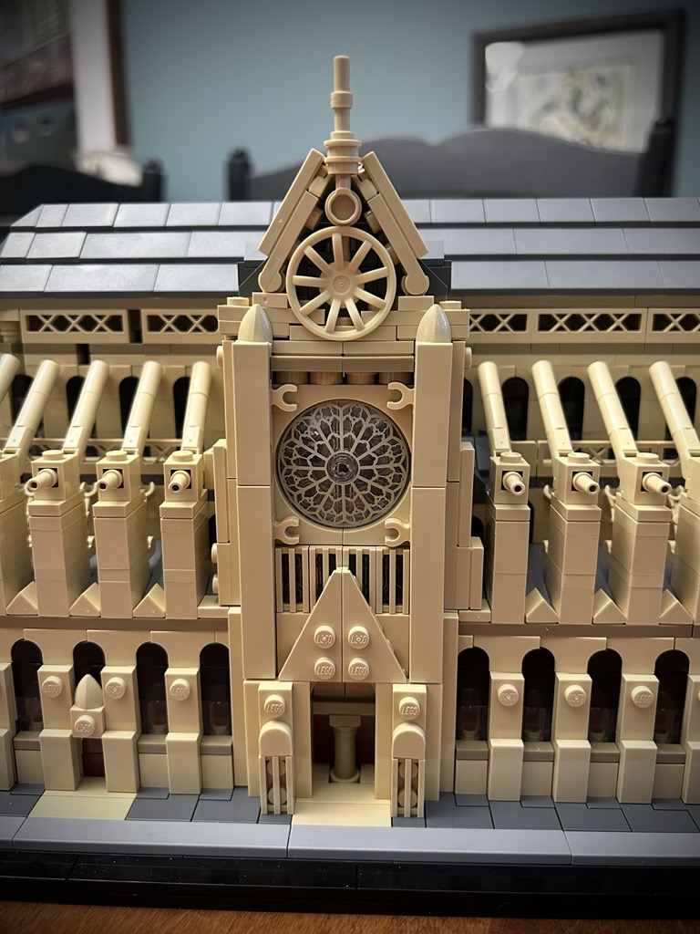
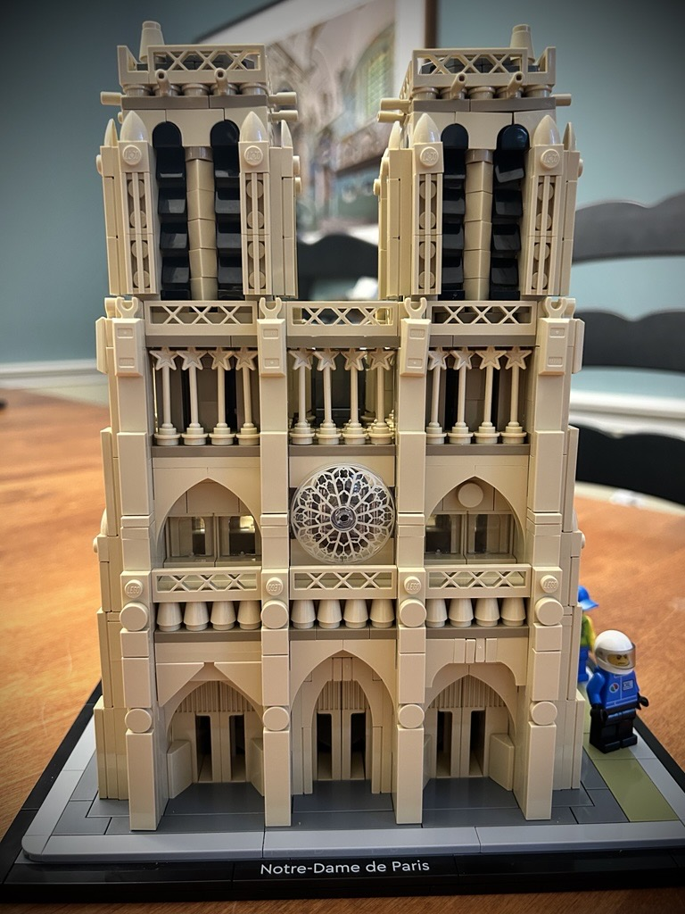
Notes:
This slide [CHILDREN’S TIME] is not shown.
VIDEO SWITCH: GOTO LS (live Stream)

Slide 16
Week 6
Completed Cathedral: Beauty

Slide 17
Notes:
This slide [CHILDREN’S TIME] is not shown.
VIDEO SWITCH: GOTO LS (live Stream)

Slide 18
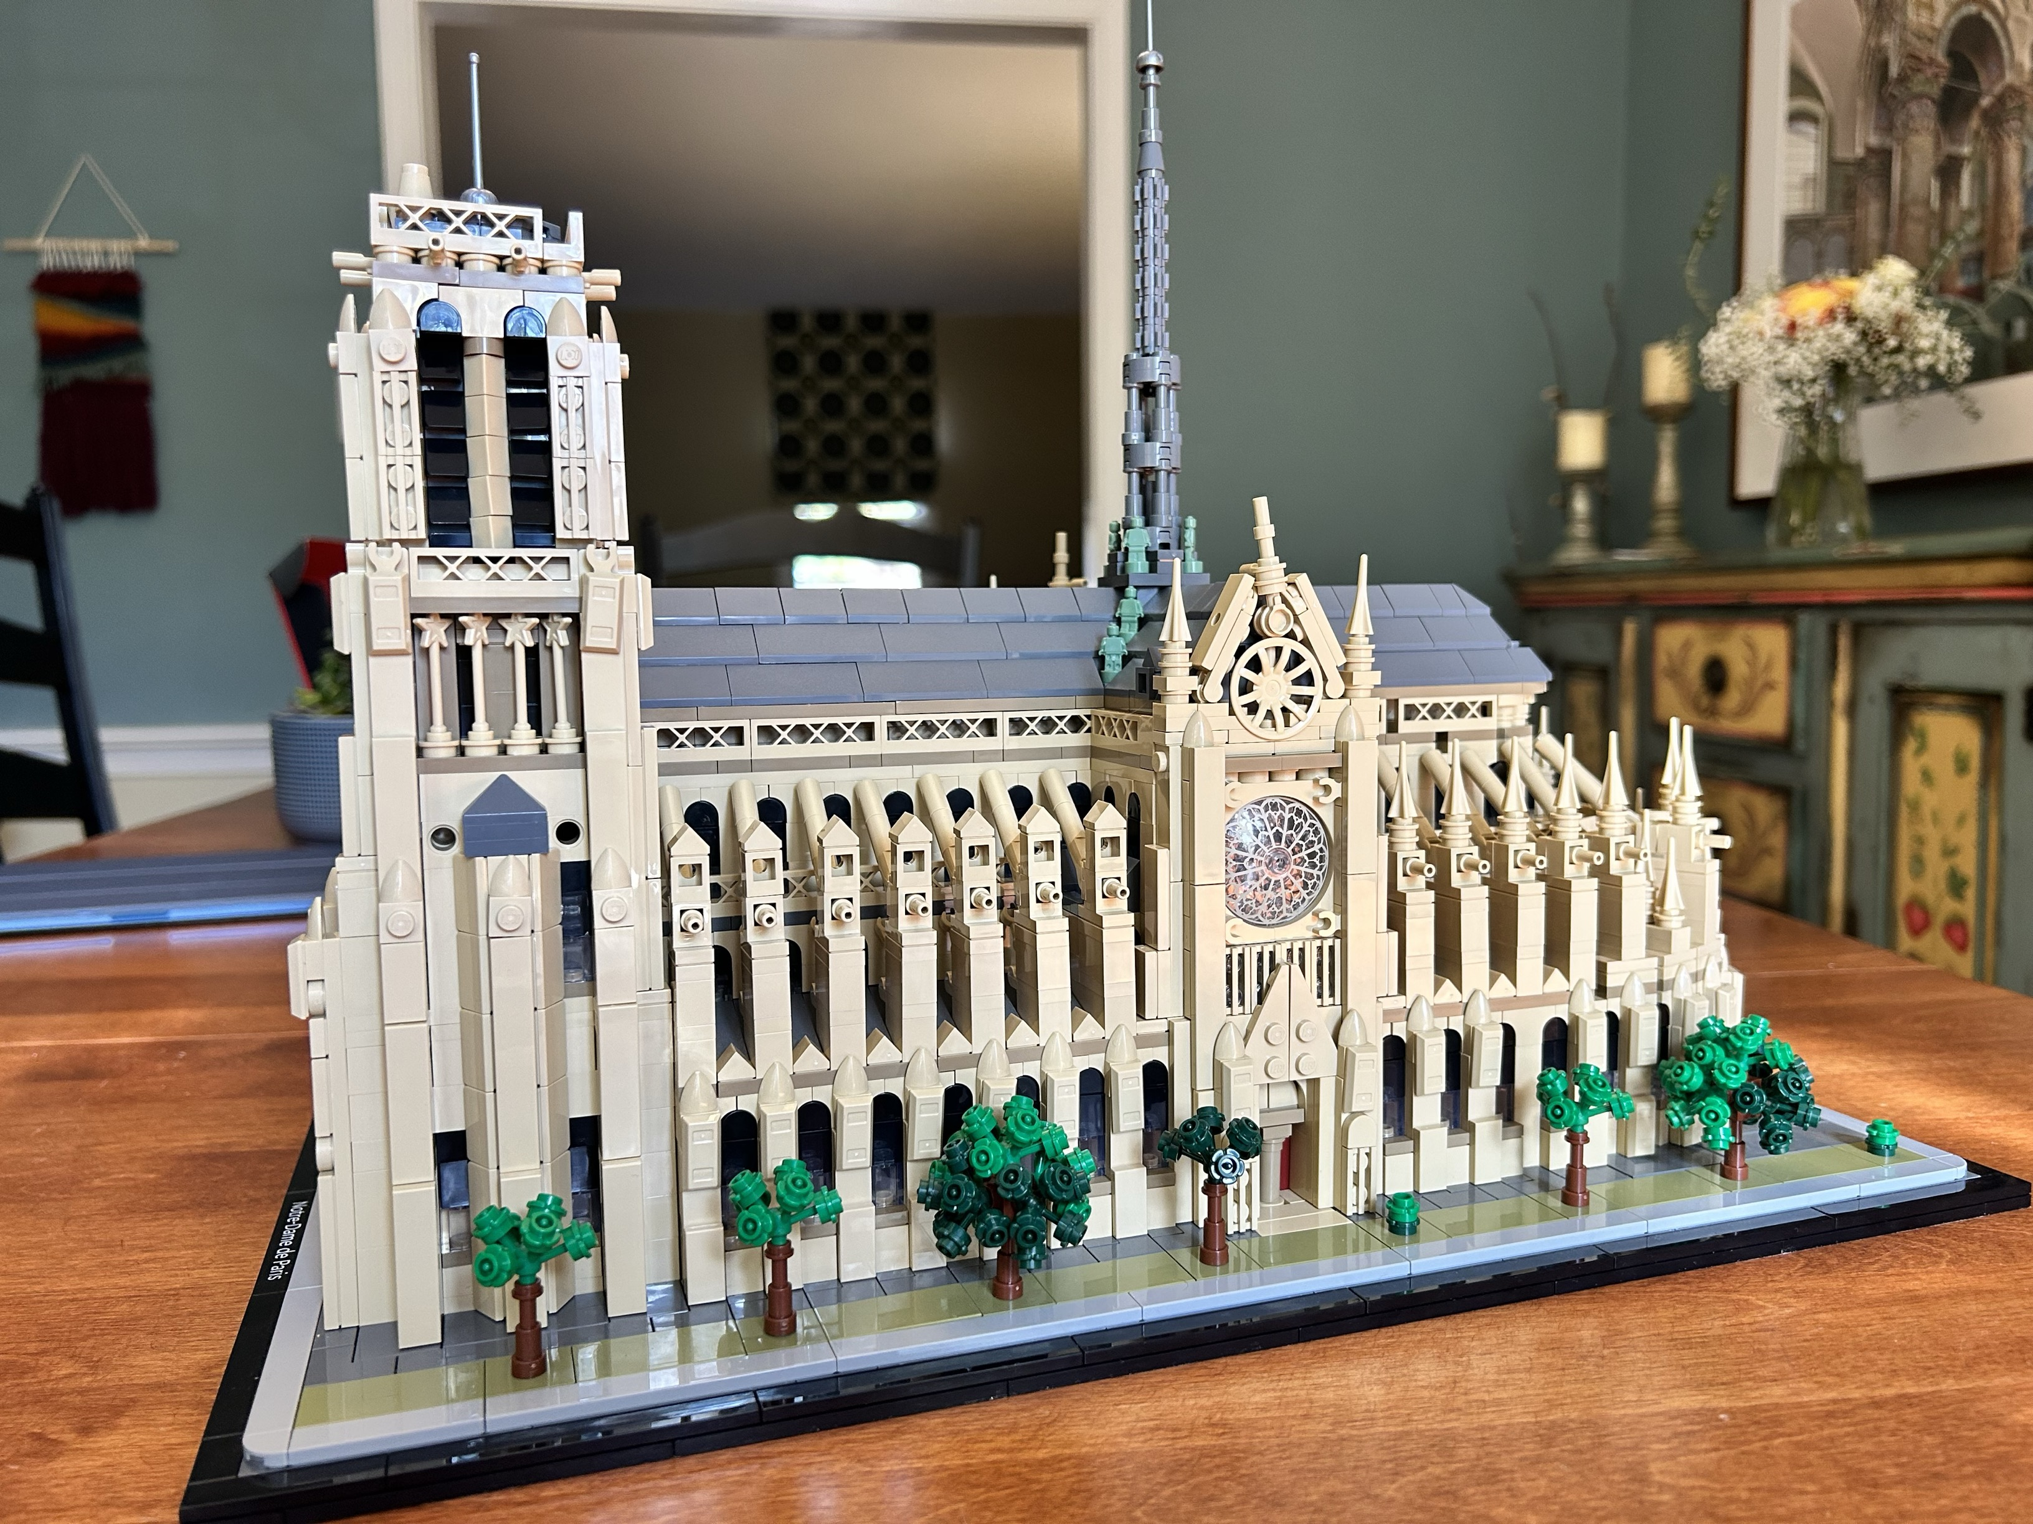
Notes:
This slide [CHILDREN’S TIME] is not shown.
VIDEO SWITCH: GOTO LS (live Stream)

Slide 19
Week 7
Light Kit: A Beacon of Light

Slide 20
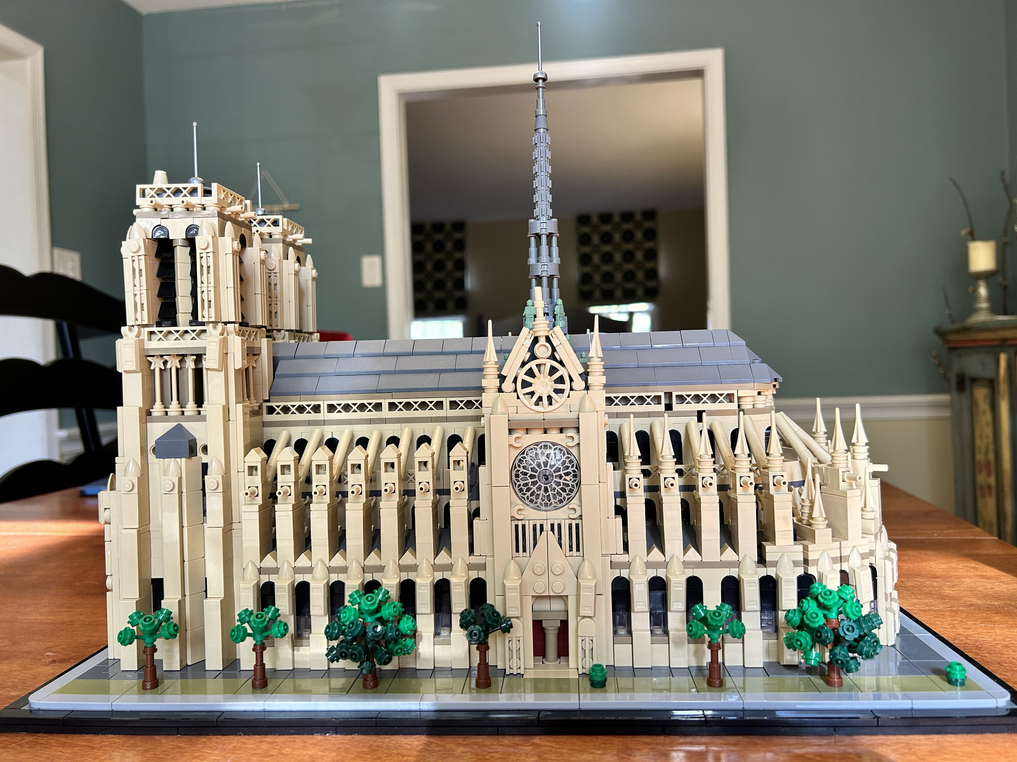
Notes:
This slide [CHILDREN’S TIME] is not shown.
VIDEO SWITCH: GOTO LS (live Stream)

Slide 21
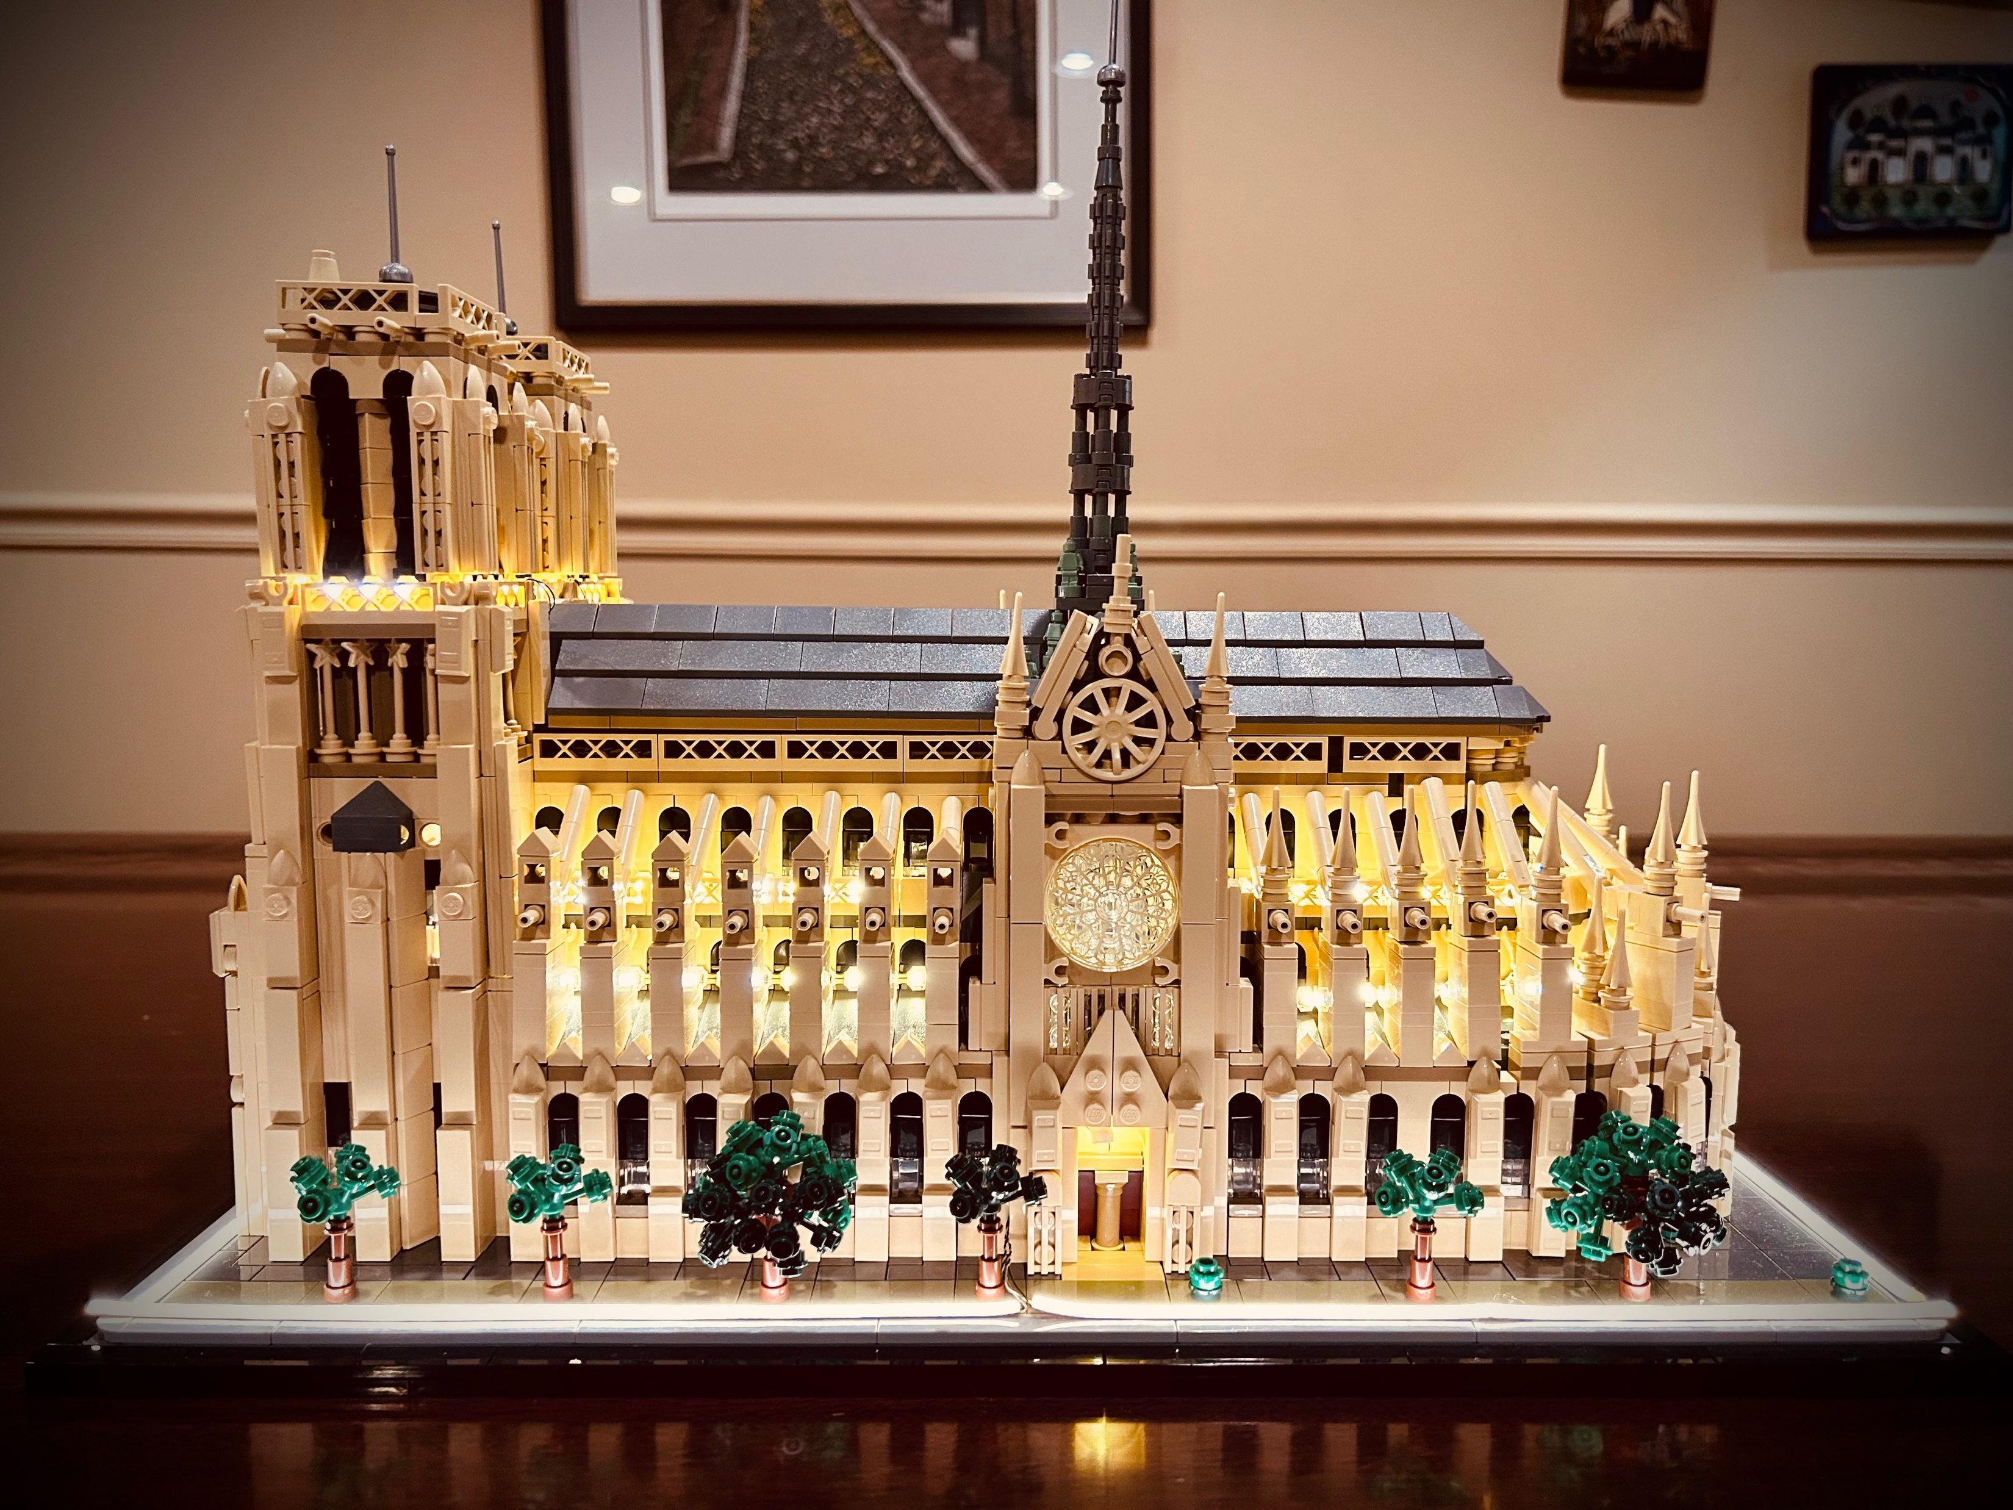
Notes:
This slide [CHILDREN’S TIME] is not shown.
VIDEO SWITCH: GOTO LS (live Stream)

